Slide 1
CO326-2022
Smart Building Project
Group B - Lighting

Slide 2
Overview
Main Objectives
Controlling lighting based on Occupancy
Controlling lighting based on Light intensity
Time stamping

Slide 3







Flow of the system
NodeMCU ESP8266
Light Sensors
Mqtt Server
Database
Web Interface
SCADA
Output Bulb

Slide 4
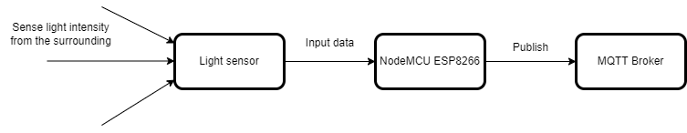
Inputs
Sensors
Light sensor - LDR
Occupancy sensor
Switches from dashboard
Notes:
Occupancy sensor data will be published by another group
So we focused on light sensor data

Slide 5
Reading Light Sensor Data & Publishing
Using the NodeMCU ESP8266 and the LDR sensor was connected to the analog pin (A0) to read sensor data.
Programmed using Arduino IDE to read sensor data every 2 seconds and publish to the MQTT server.

Slide 6
Outputs
3 Light bulbs and 1 LED
Control
4-channel Relay Module
Light Bulbs
Output - ON/OFF
MQTT Broker
Subscribe
NodeMCU ESP8266
LED
Output - Brightness value

Slide 7
Steps
Subscribe MQTT broker on following topic convention to get the command to whether light is on or off and to change the brightness value of LED.
326project/smartbuilding/lighting/<floor_number>/<room_number>/switch/inside/<led_number>/
Then NodeMCU is programmed using Arduino IDE to control 3 digital pins as ‘High’ or ‘Low’ and 1 digital pin to change brightness value depending on the result of subscribed mqtt topics.
Control decisions taken by NodeMCU are transferred to 4-channel relay module and then light bulbs are powered using relay based on the control decisions.
Finally the status of the bulb is published to MQTT broker.

Slide 8
SCADA Interface
Read data from MQTT Server and display the status of system on SCADA
Source of data - MQTT server
SCADA is considered as a MQTT client which subscribed to relevant topics, so that the published data of sensors and actuators can be read.
326project/smartbuilding/lighting/<floor_number>/<room_number>/lightsensor/inside/<sensor_number>/
326project/smartbuilding/lighting/<floor_number>/<room_number>/switch/inside/<led_number>/
326project/smartbuilding/lighting/<floor_number>/<room_number>/switch/outside/<led_number>/
Output - Status of the system
Displayed through node red dashboard.
Components status and other relevant details of the lighting subsystem.

Slide 9
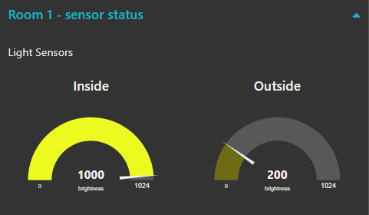
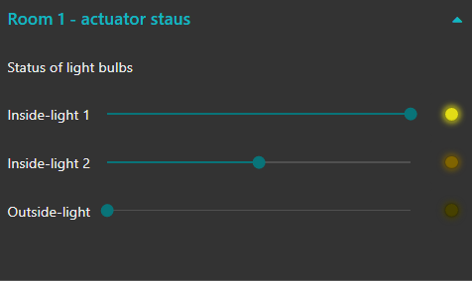
SCADA Interface - Real time data
Sensor Data Actuators Status
Light intensity level Brightness level

Slide 10
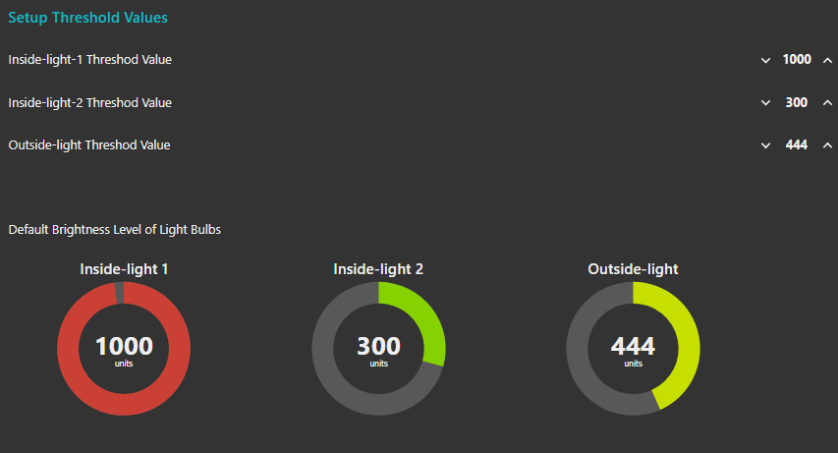
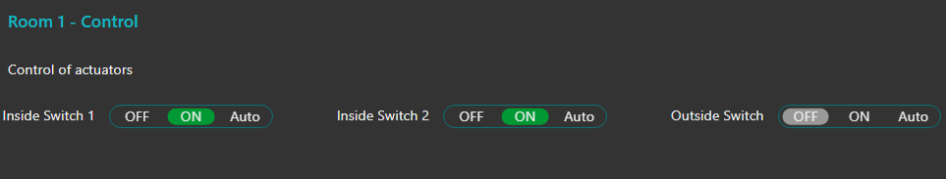
SCADA Interface - Input from SCADA
Function to allow user to setup default threshold level of the system components
Function to allow user to set the mode for the system functioning

Slide 11
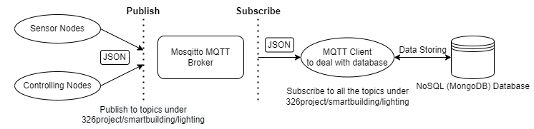
Storing Data to Database
Used Collections on MongoDB,
co326_lighting_sensor_data
co326_lighting_control
co326_lighting_status

Slide 12
SCADA Interface - Historical Data
Source of data
Collections from MongoDB Database
Output
Charts and tables showing the variation against the time in the node red dashboard
Data display can be categorized as,
Sensor Reading vs Time (LDR Sensor readings)
Control Data vs Time
Status Data vs Time

Slide 13
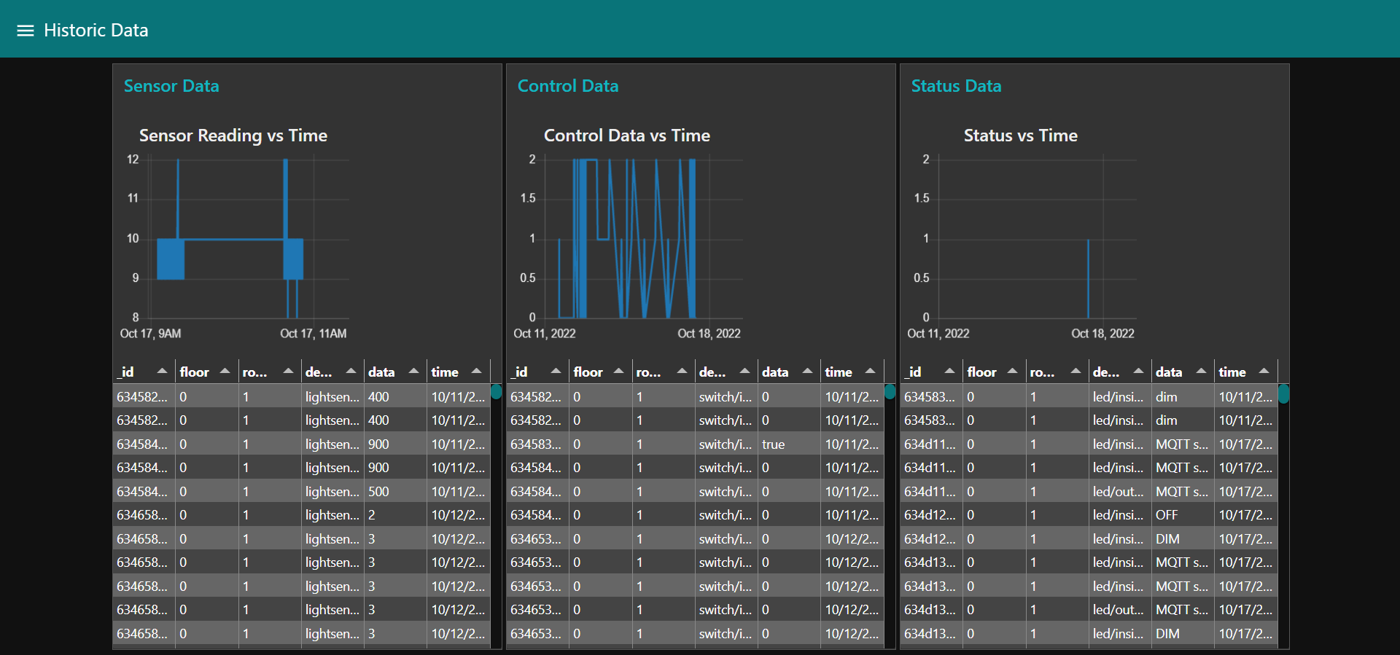
SCADA Interface - Historical data
Sensor Reading vs Time-
LDR Sensor readings

Slide 14
Control Data vs Time
0: Manual Off
1: Auto
2: Manual On
Status Data vs Time
Light Intensity
0 : Light Off
1 : light On

Slide 15
Process control
In our lighting controllers, there are two main processes.
Turn the lights ON/OFF
Adjust light output up and down using a dimmer.
Our Main control strategies.
Manual control
Occupancy based control
Time scheduling control
Control according to the Daylight response(Using LDRs)

Slide 16
Process control
Combining the main control strategies we developed four process control techniques using four algorithms.
For Non Dimmable lights
Manual control + Daylight response + Time scheduling
Manual control + Time scheduling
Manual control + Occupancy control + Daylight response
For Dimmable lights
Daylight response
Outside lights
Inside lights

Slide 17
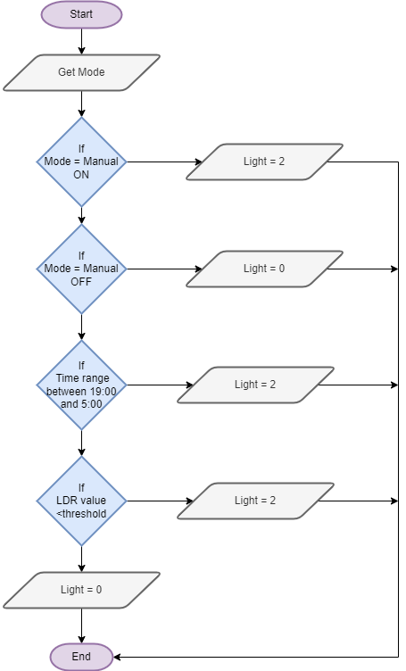
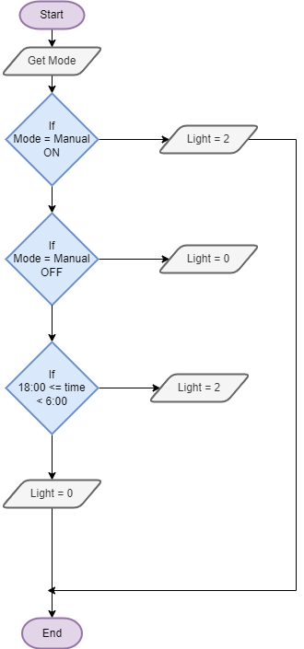
Manual control + Daylight response + Time scheduling
Manual control + Time scheduling

Slide 18
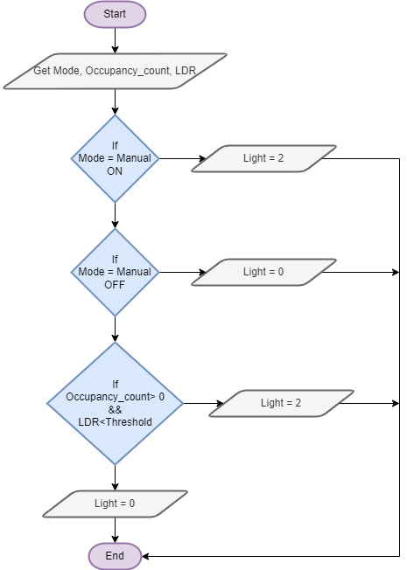
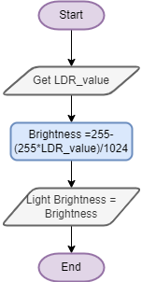
For Dimmable lights
Manual control + Daylight response + Time scheduling
Manual control + Daylight response

Slide 19
Hardware Demonstration

Slide 20
Data Analytics
Source of data -
Collections from MongoDB Database
Historical data from SCADA interface
Outputs -
Graphs to show correlation between time and the sensor readings and time and the control signals.
Threshold value calculation for future predictions and optimization of resources.

Slide 21
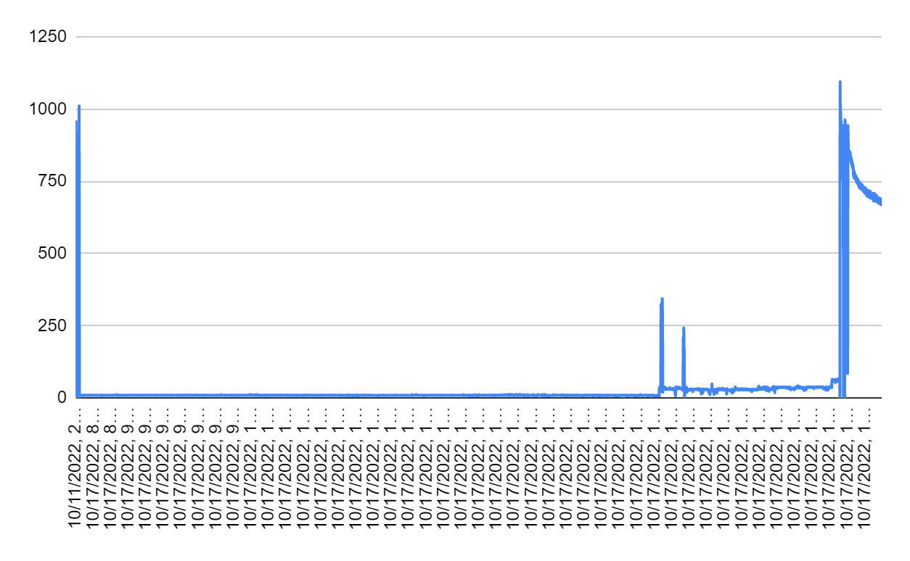
LDR Sensor Readings Vs Time (For a dummy data set)
A threshold time for a LDR reading above a specific value can be obtained by analysing reasonable amount of data in this kind of a graph.

Slide 22
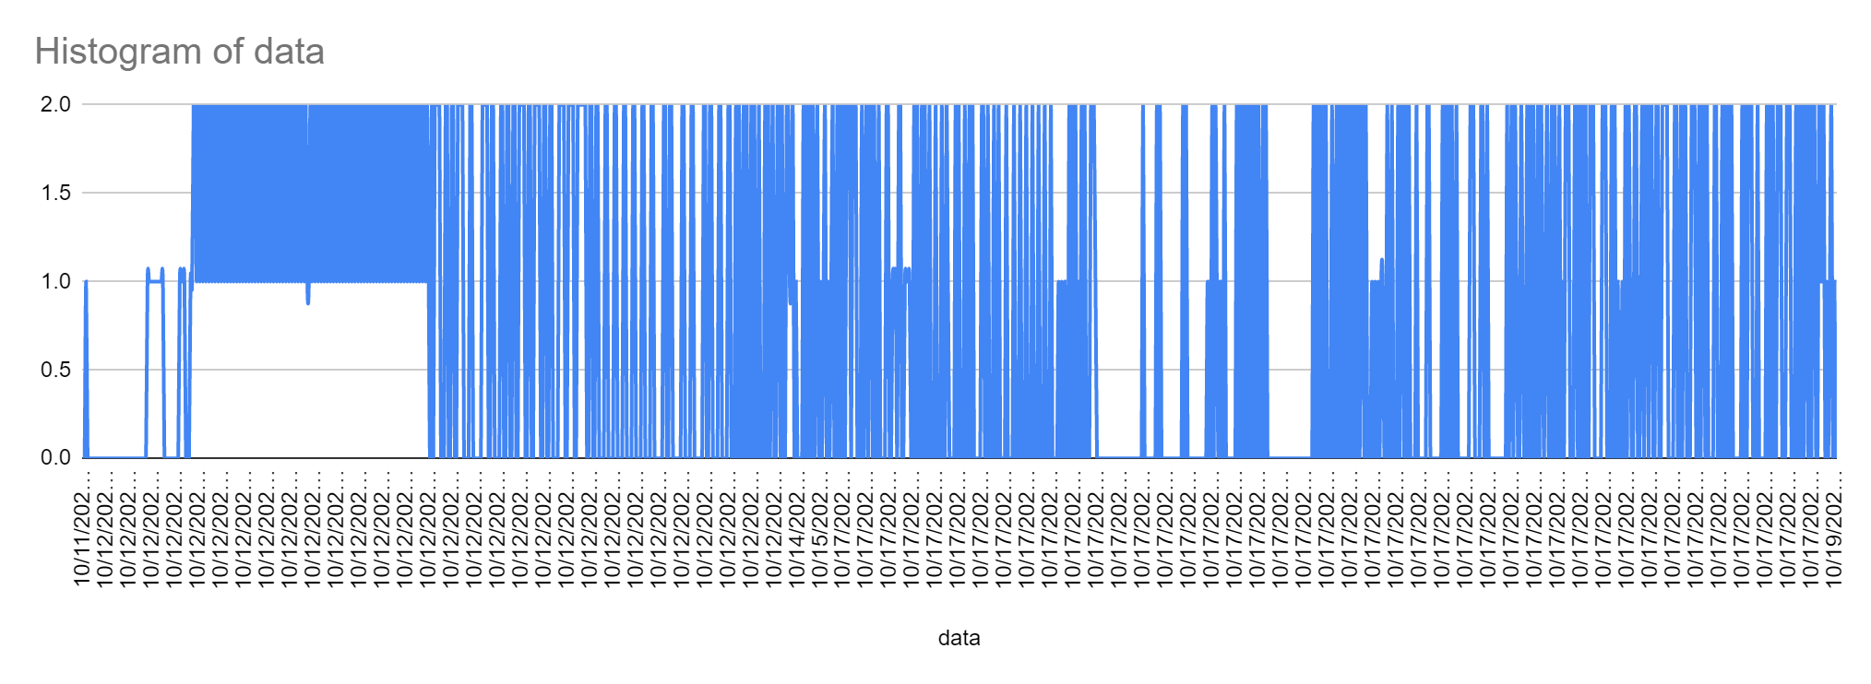
Control decision (0,1 or 2) Vs Time
From this it can be predicted usual time slots that the light is needed to be ON and time slots that usually don’t need to turn ON the lights.

Slide 23
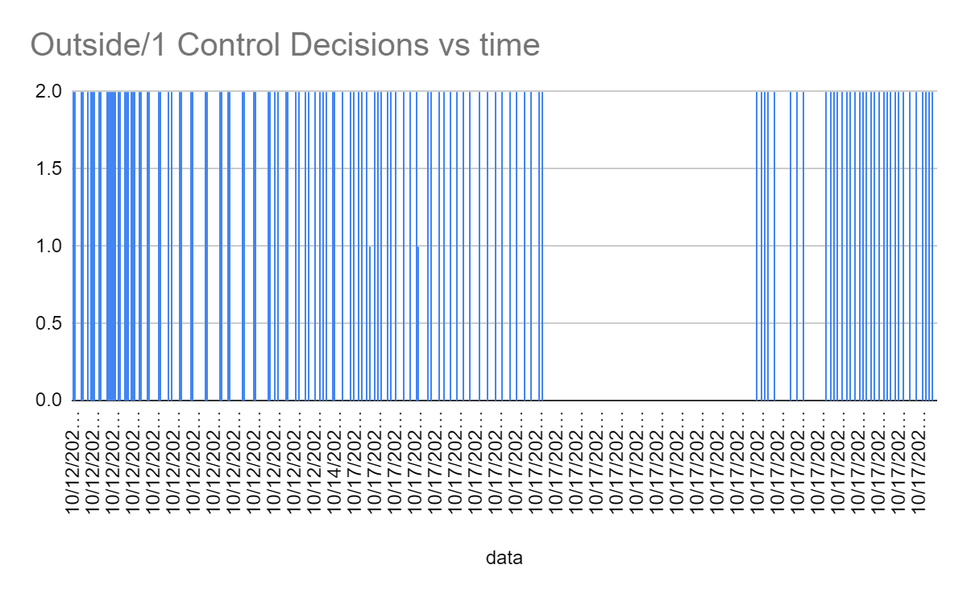
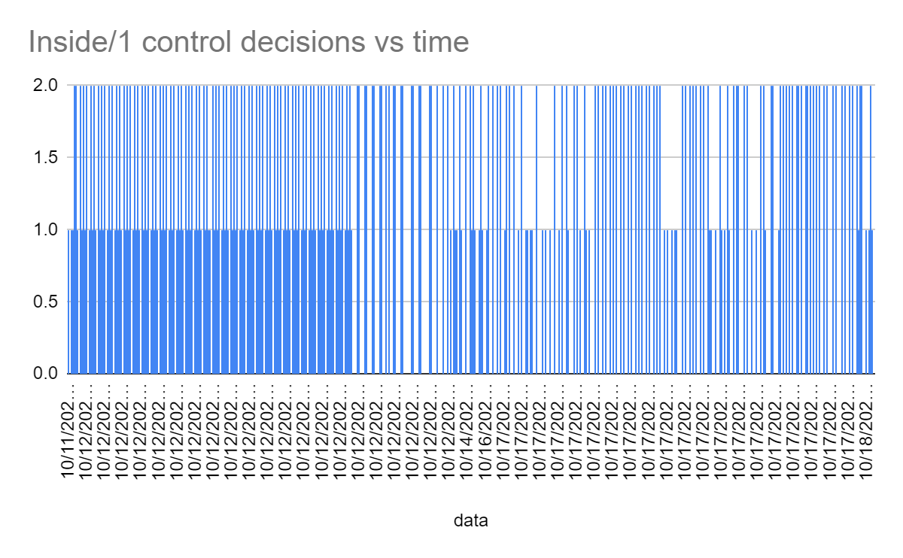
Variation of Control Decisions with different lights

Slide 24
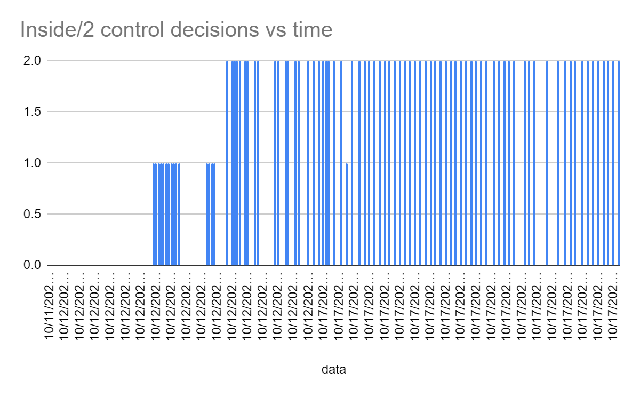
Variation of Control Decisions with different lights
By analysing above graphs it can be observed that usually which lights are ON or OFF in a particular time period and this can be used for future optimizations and predictions.

Slide 25
Thank you

